Slide 1
Using Machine Learning to predict essential genes
Hamed Haseli (hamedhm@ebi.ac.uk)
Jan 2019, Munich

Slide 2
Our question: Can we predict whether a gene will result in a lethal phenotype once knocked out?

Slide 3
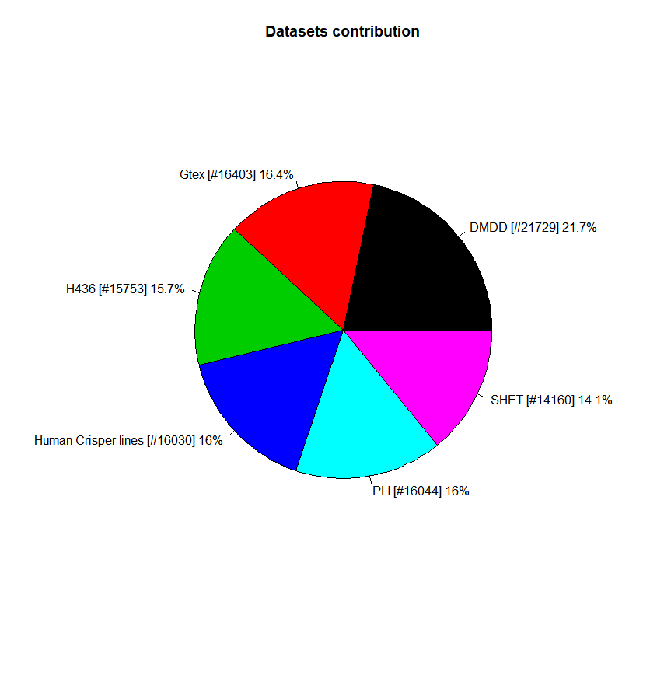

Data resources
Human essential scores Avana data, based on 400+ cell lines
pLI probability of being loss-of-function intolerant, based on ExAC data
S-HET selection against heterozygous loss of function, based on ExAC data
DMDD whole embryo transcriptome data (Expression Atlas)
436H
Missing removal/imputation
pLI
Missing removal/imputation
S-het
Missing removal/imputation
DMDD
Missing removal/imputation
Human essential scores based on knockouts of 11 human cell lines
GTEX human expression data
Other operations
Other operations
Hscore
Missing removal/imputation
Other operations
Other operations
Duplication removal
Transformation
Randomization
GTEX
Missing removal/imputation
Duplication removal
Transformation
Randomization
Duplication removal
Transformation
Randomization
Duplication removal
Transformation
Randomization
Other operations
Other operations
Duplication removal
Transformation
Randomization
Duplication removal
Transformation
Randomization
IMPC viability
DR7
Violeta Muñoz-Fuentes

Slide 4
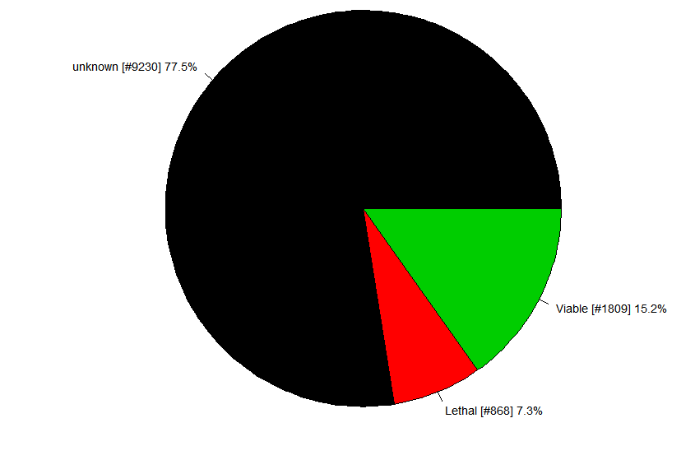
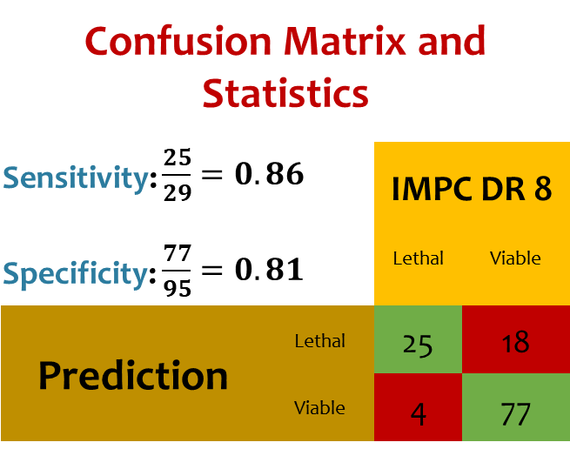
Training
Validation
IMPC DR7
IMPC DR8
Link to the raw data
Confusion Matrix and Statistics
Sensitivity: $\frac{25}{29}=0.86$ Specificity: $\frac{77}{95}=0.81$ |  | IMPC DR 8
 |  | Lethal | Viable
Prediction | Lethal | 25 | 18
 | Viable | 4 | 77
Random Forest
Training dataset
80% training
20% test

Slide 5
Further topics to discuss
Determine what input data is most informative
Other ML methods that would be worth exploring
Any other ideas or feedback

Slide 6

Q&A
more questions? email me

